Slide 1
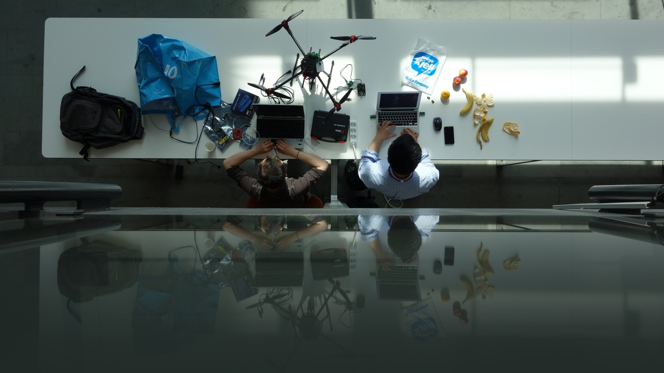
E-HACK 2015
E-HACK 2015 Fall
Explore, Create, Innovate
Oceania 7th – 8th of may
Save The World ICT STYLE!
3-4 December

