Slide 1
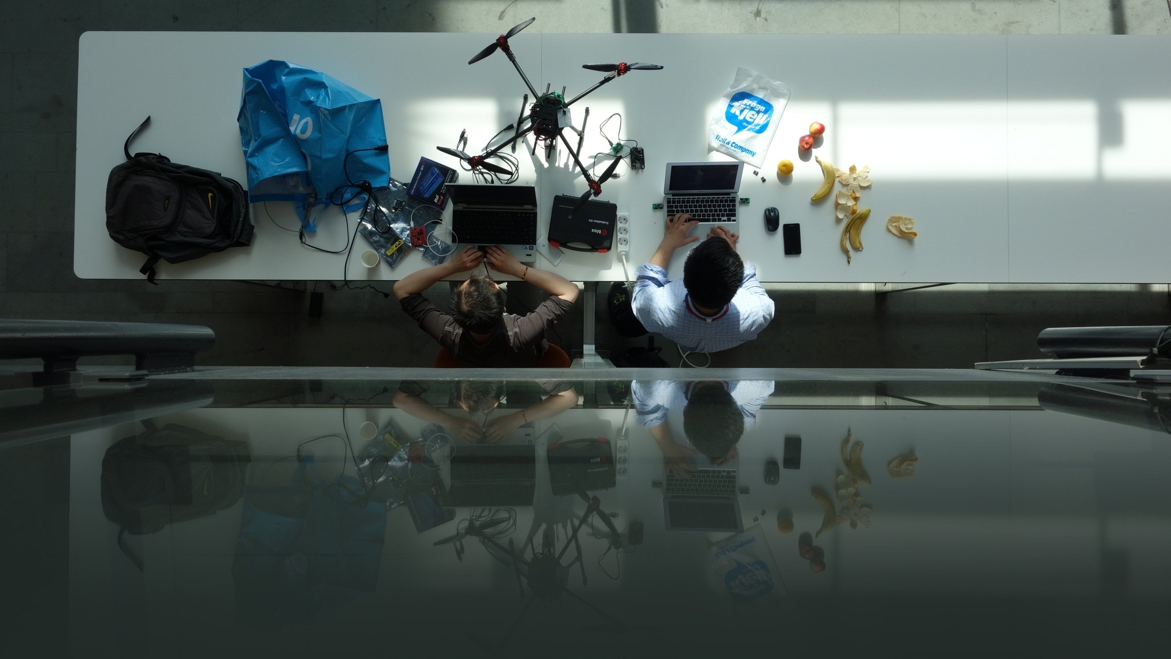
E-HACK 2015
E-HACK 2015
Explore, Create, Innovate
Oceania 7th – 8th of may
Explore, Create, Innovate | Oceania 7th – 8th of may

