Slide 1
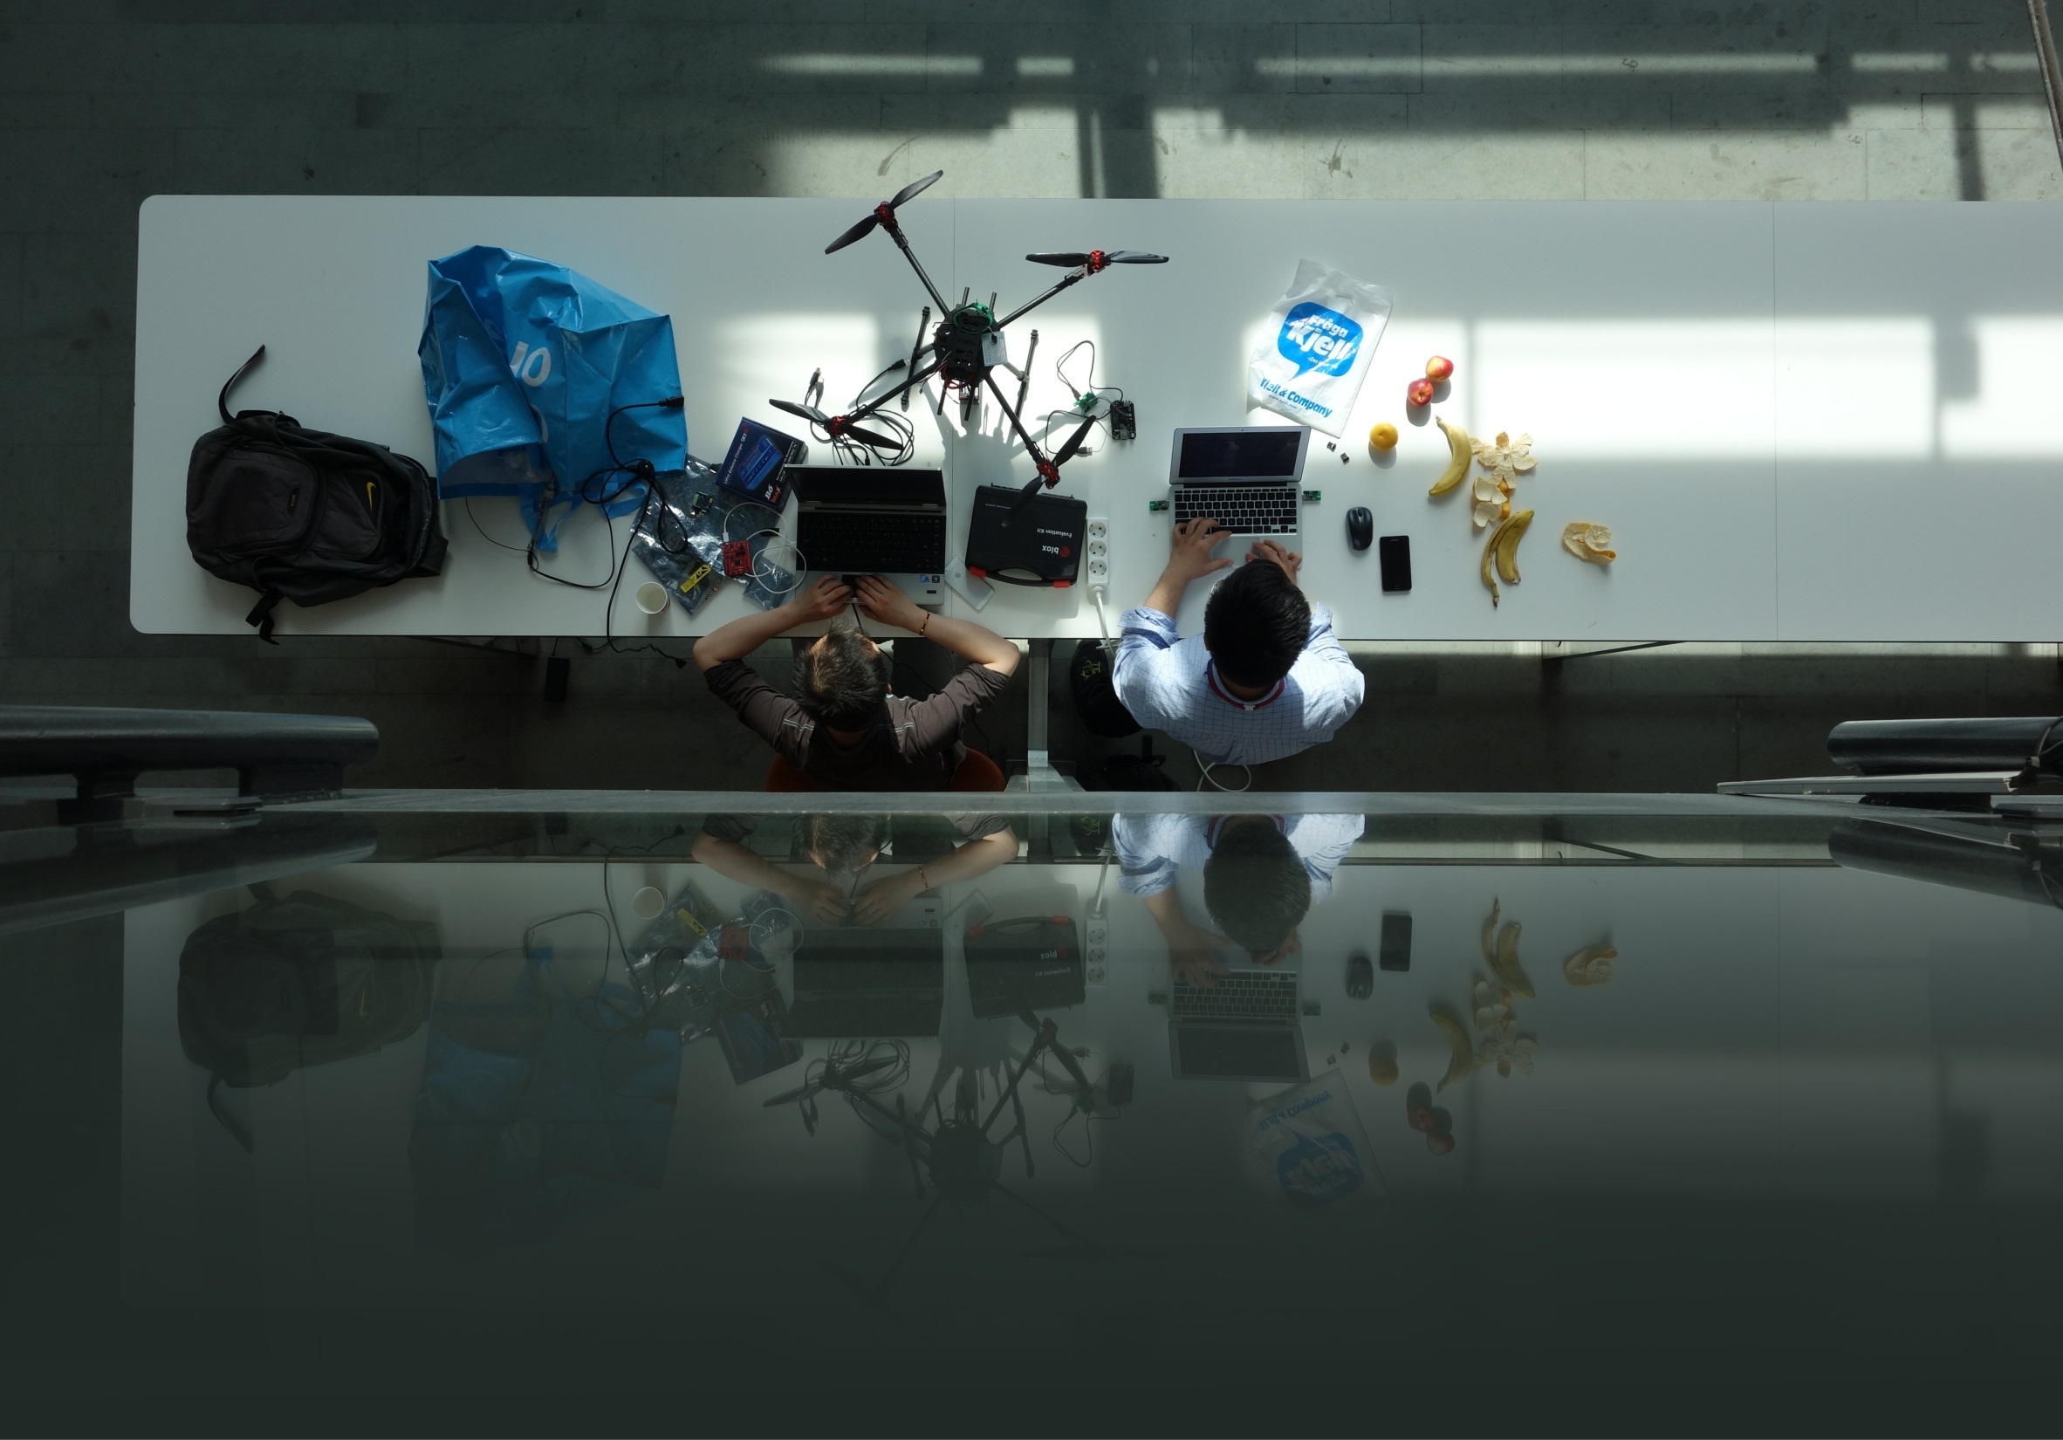
E-HACK
Explore, Create, Innovate

Slide 2
Daniel Collin (DURA/GWMR)
Ziver Koc (DURA/GWMR)

Slide 3
AGENDA
History
What it is?
Mission
Who are we?
Previous events
Demo
Q&A
of 1337

Slide 4
HISTORY
The idea was born at a learning day session
@WMR in 2013
First pilot event was held late 2013
Bi-annual Kista-only event starting 2014
Growing number of participants
Last two events has included Students

Slide 5
WHAT is it?
Hackathon inspired event
  Pitch
  Not limited to existing Ericsson domains. Maybe a hobby of yours?
  Demo (~24h later)
Focus Areas:
  ”Green house” – Work on any type of project
  Event specific – Defined theme

Slide 6
MISSION
Outside the box thinking
  Experiment
  Get Inspired
  Push Boundaries
  Expand Perspectives
Internal + External branding
  Make people proud to work at Ericsson.
Meet new people (Ericsson Kista + students)
  Inspire others – let them inspire you.
Software craftsmanship (not limited to)

Slide 7
- Steve Jobs
“The journey is the reward”

Slide 8
- Bill Gates
“It's fine to celebrate success but it is more important to heed the lessons of failure”

Slide 9
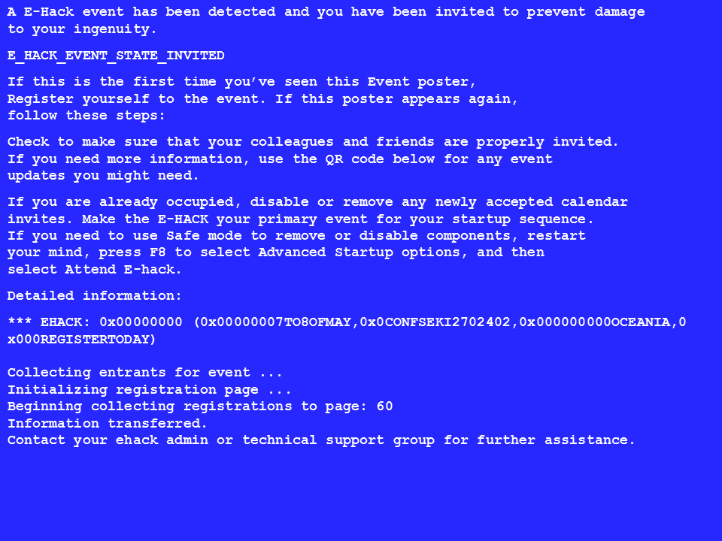

Slide 10
WHO ARE WE?
DUNC - Anna-Karin Mcdonald, Gianfranco Alongi
DURA - Ziver Koc, Daniel Collin
BUSS - Johan Kölhi, Michael Huber T
Ericsson Research - Stefan Ålund
HR/Head of Employer Branding Sweden – Anders Österlund

Slide 11
WMR PILOT LATE 2013
Pilot event
8 hours
WMR only
Projects:
Vocal interactive software (”Hal”)
Shared Spotify playlist
Eclipse plugin for BlockTest

Slide 12
E-HACK 2014 Spring edition
BUSS Media
”Show us what you can do with a ChromeCast”
Projects:
Wireless power consumption meter
Software compensation for broken hardware in a quad-copter
”Sumo wrestling” robots
TDD in Excel
Speech controlled software
Arduino based robots
Video documentation of E-hack
Multiplayer Pong on a ChromeCast
c++ Client-Server text based game
Game themed radiator in Erlang
Autonomous toy car with WiFi
Chinese source code translator for Python

Slide 13
E-hack 2014 fall edition
Ericsson Research
”Show us what you can do with OpenWebRTC”
(Ericsson open source video streaming framework)
Projects:
Cross platform P2P decentralized chat app
Video documentation of E-hack
Automatic movie categorization and proposals based on subtitles
Automatic power cycle of hanging UEs
Group video chat client in a browser
Motion detection with OpenWebRTC
Serverless video chat with OpenWebRTC
Android app for remote control of scene lights
OpenWebRTC on Raspberry Pi

Slide 14
NEXT event: 7-8 may
This Thursday – Friday
Oceania
Invite sent out
Expecting ~50 Ericsson + ~50 students
Still some seats left, register
Or just joint the DEMO (Friday ~11:00)

Slide 15
E-hack 2015 spring edition
DURA LMR
”Help us to evolve our Raspberry Pi based lab monitoring solution”
Projects:
TBD

Slide 16
VIDEO, YAY!

Slide 17
DEMO

Slide 18
”HAL”
Vocal Interactive Software

Slide 19
Wireless Power Consumption Meter

Slide 20
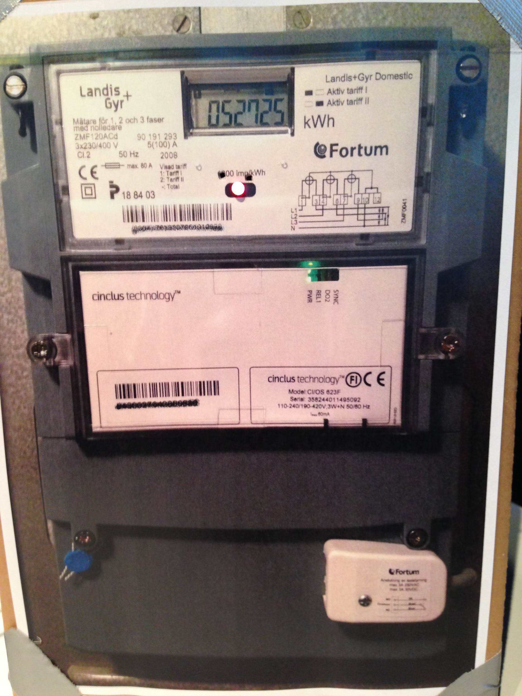

Slide 21
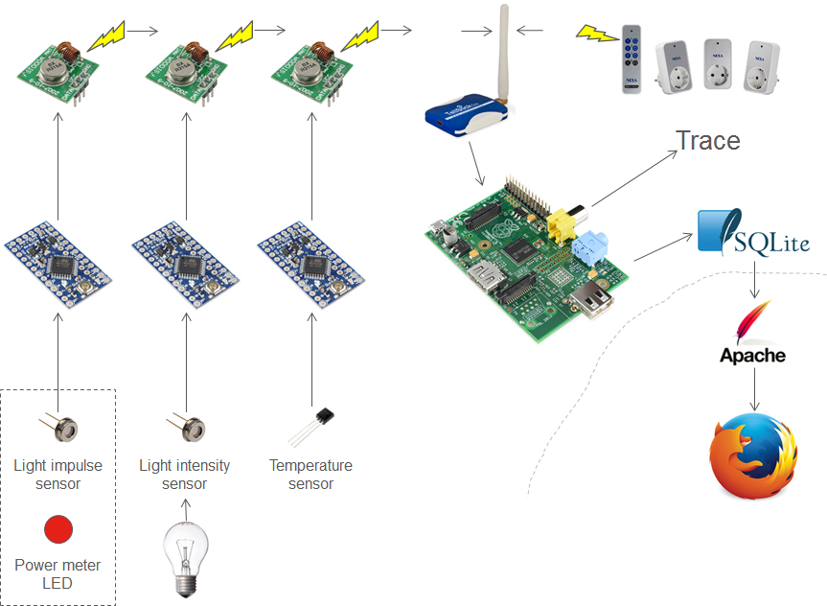

Slide 22
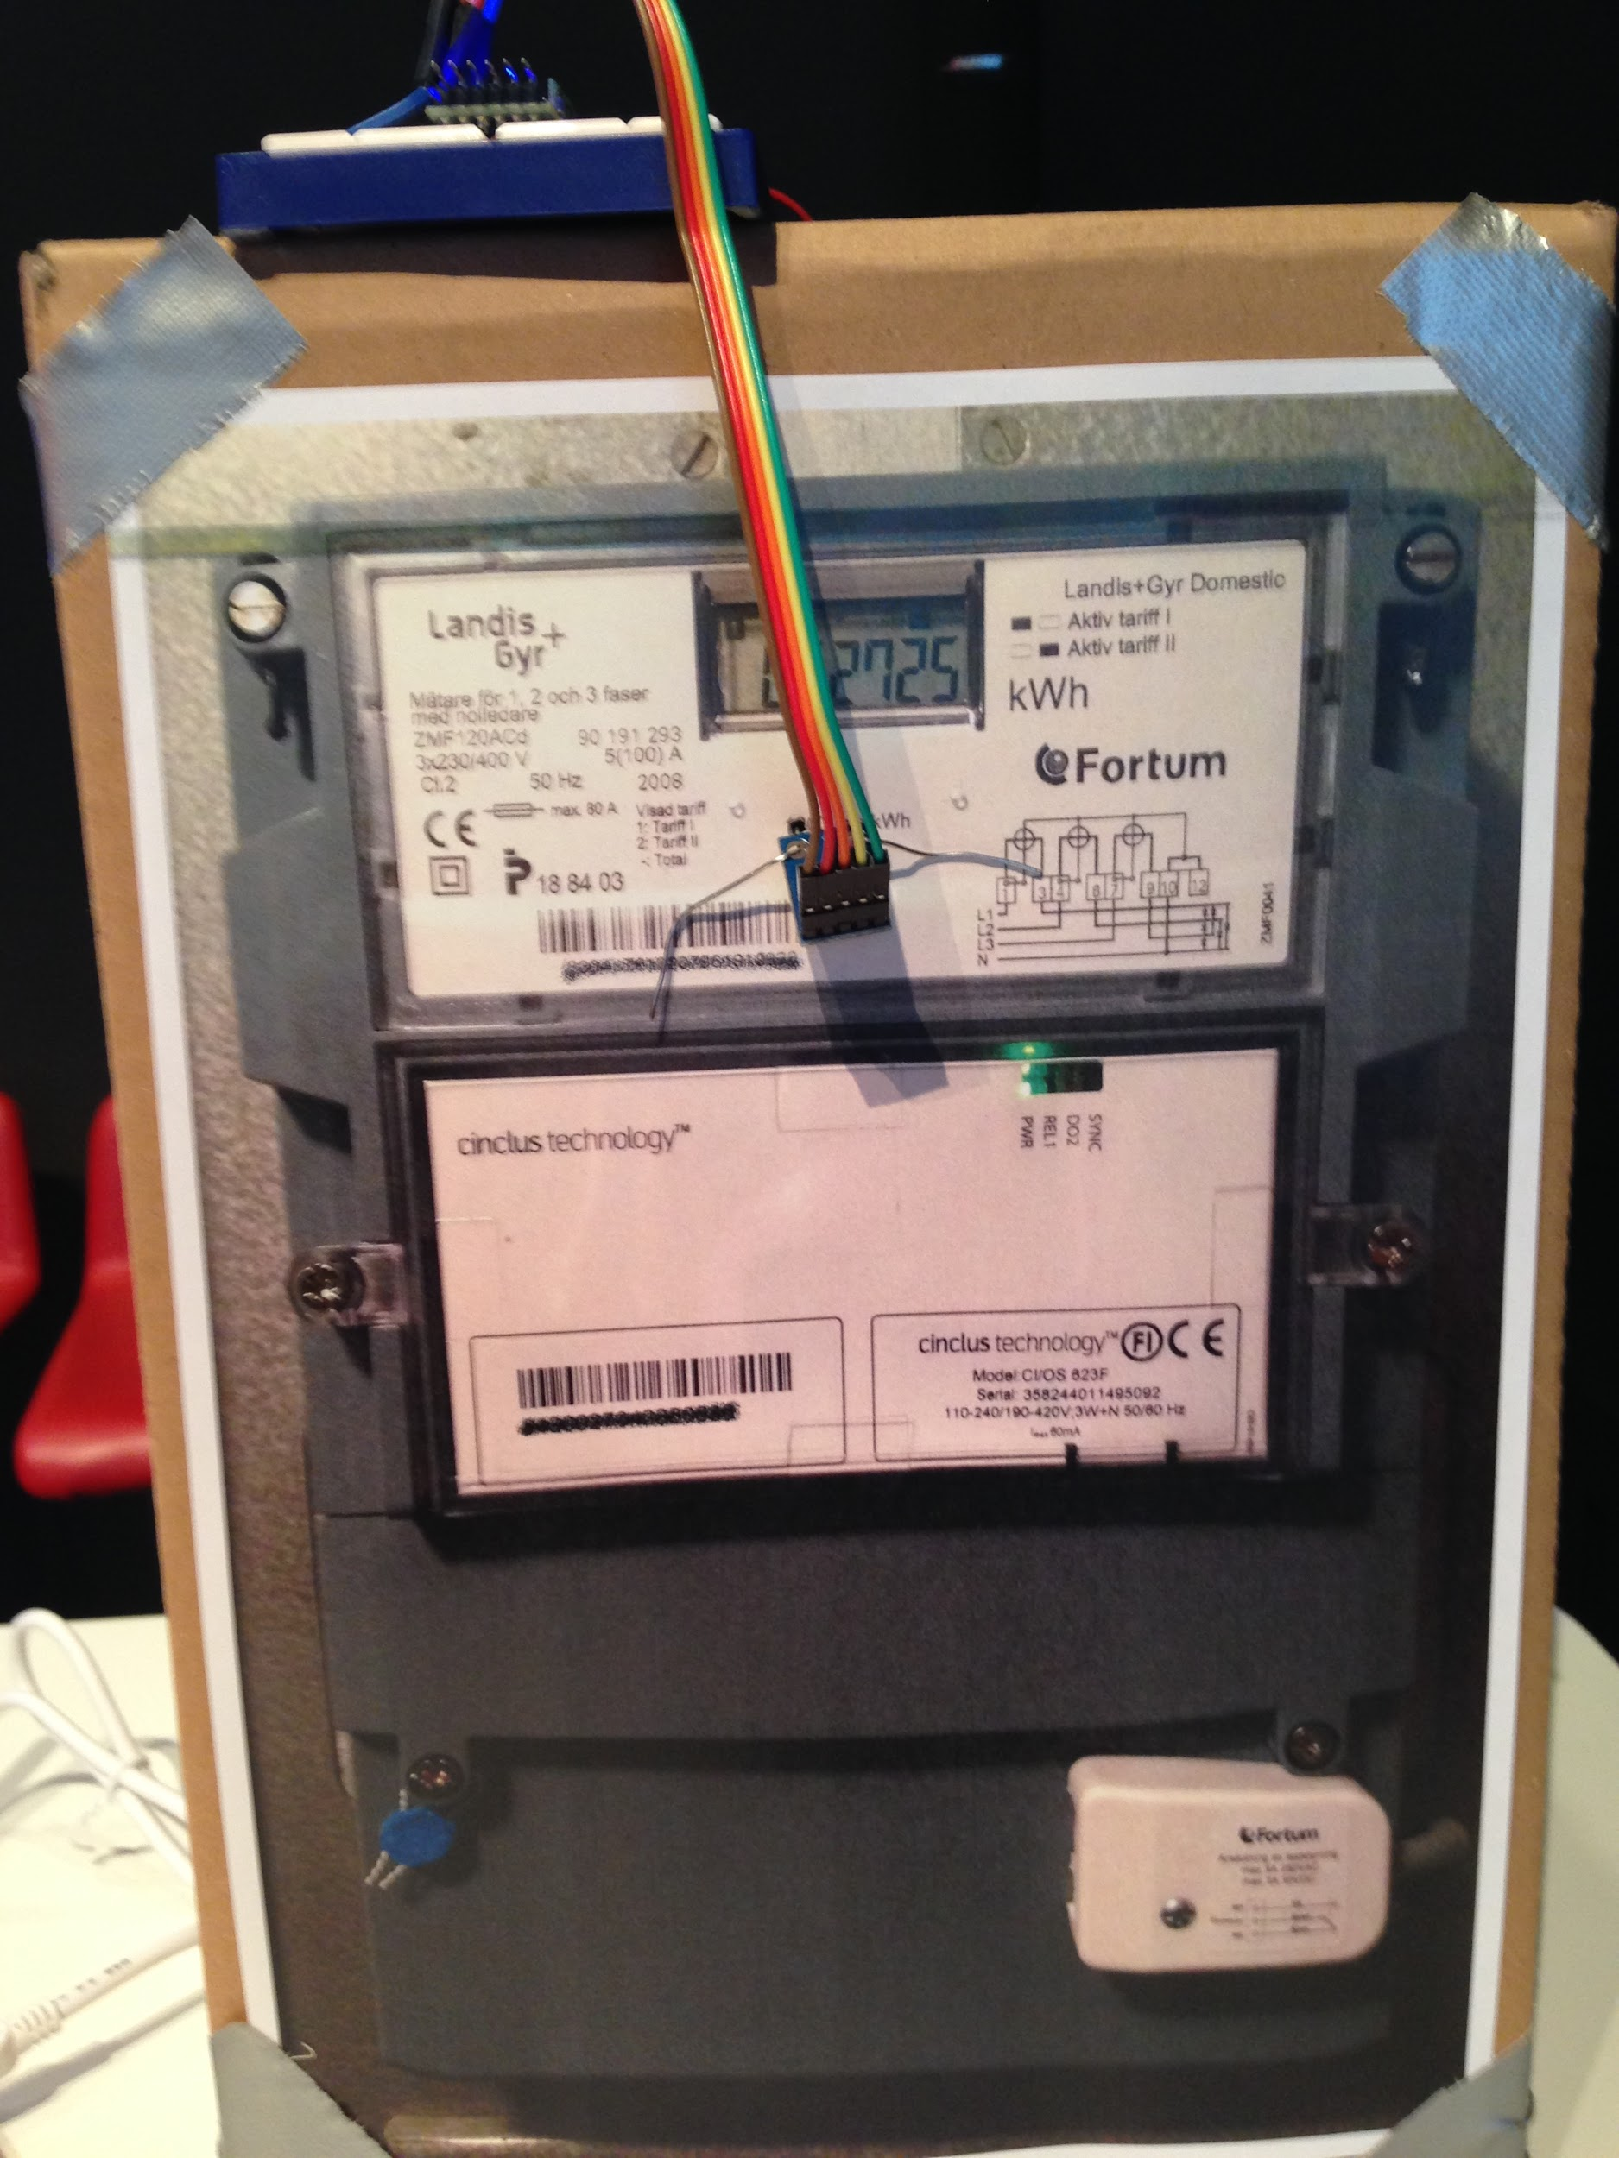

Slide 23
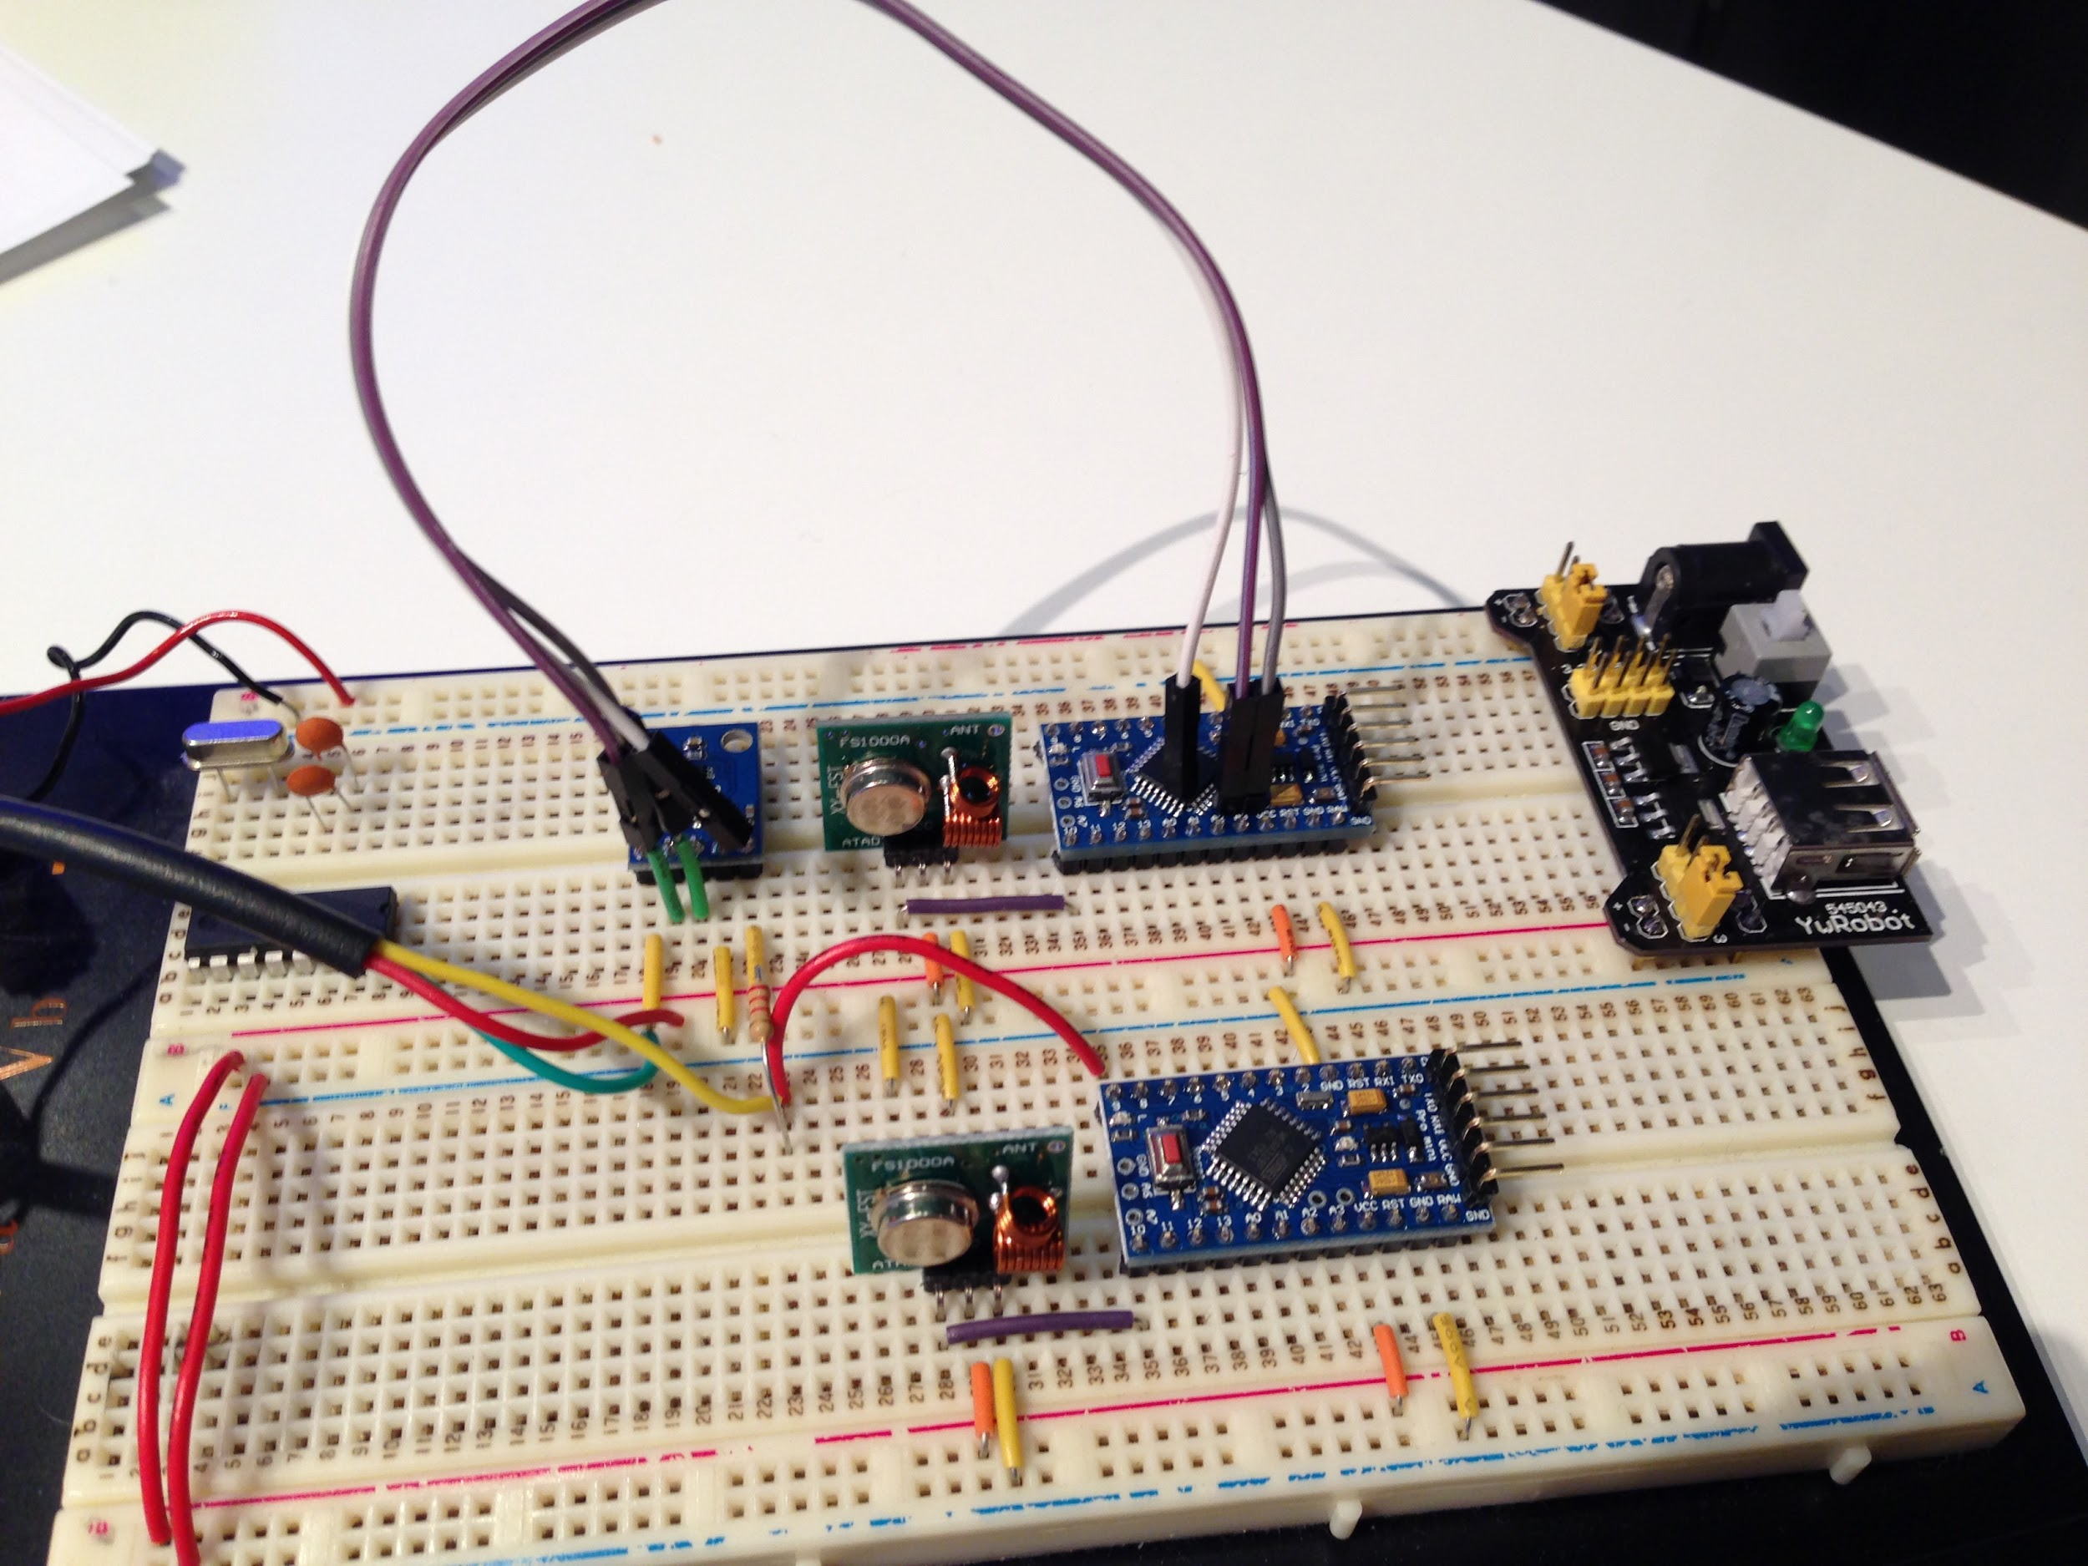

Slide 24
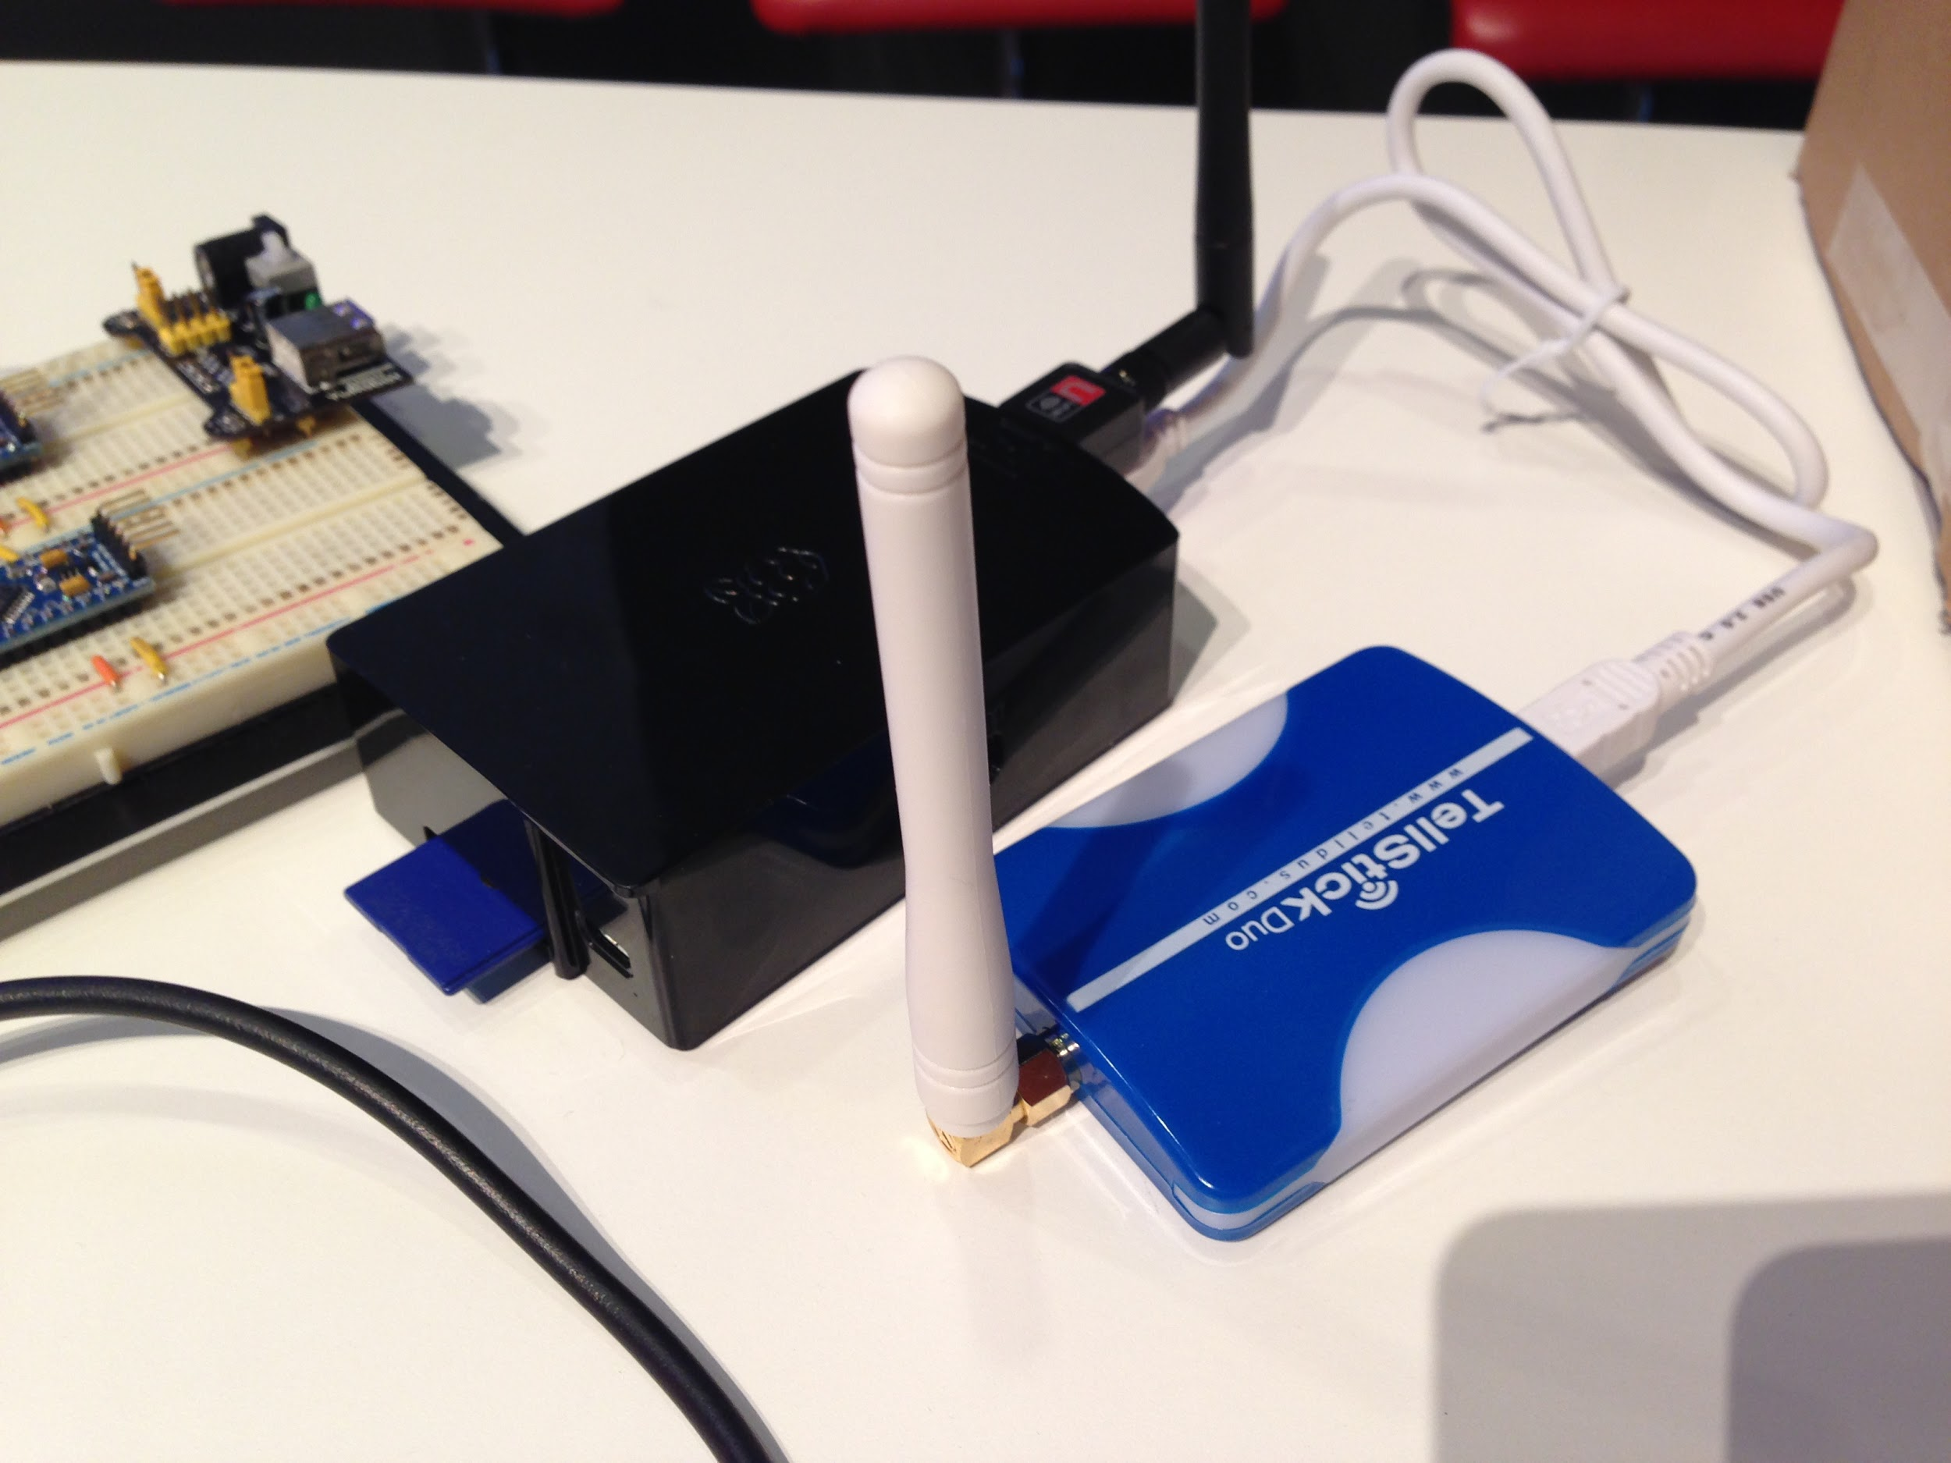

Slide 25
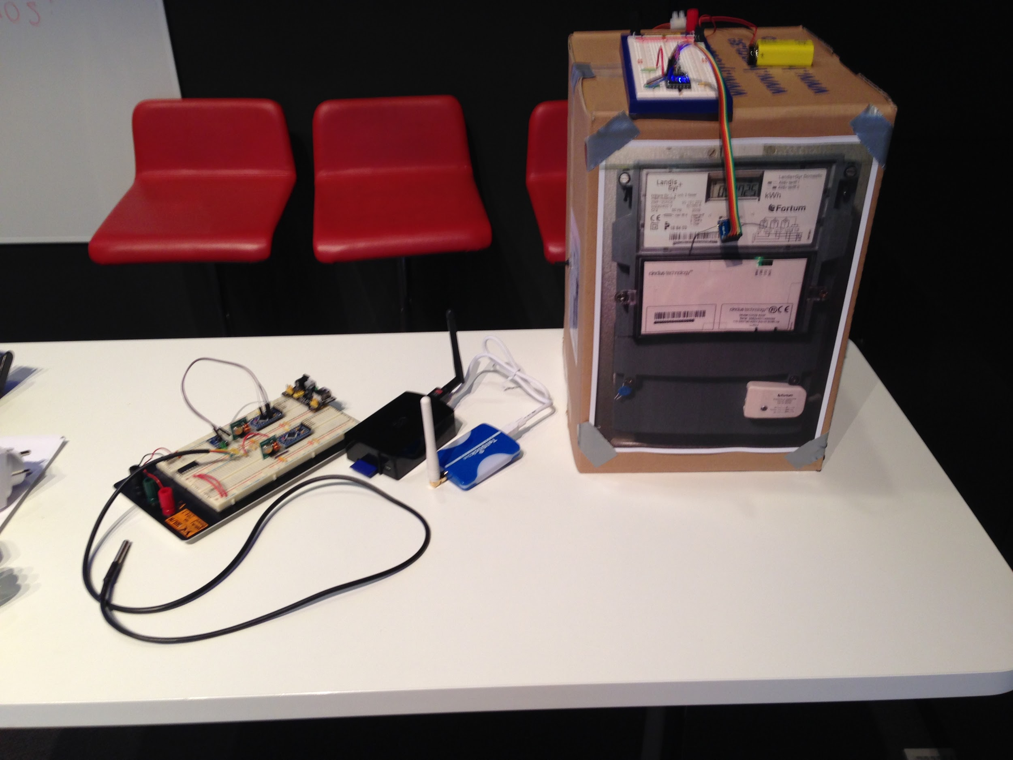

Slide 26
“ZEP CHAT”
Cross Platform Encrypted P2P Decentralized Chat App

Slide 27
ZEP chat
Zero Conf
Encrypted
P2P
Decentralized (no “server”)
Cross Platform
  Android
  IOS

Slide 28
Q&A

Slide 29
VERY LOOOOONG TIMELAPS

Slide 30


